Slide 1

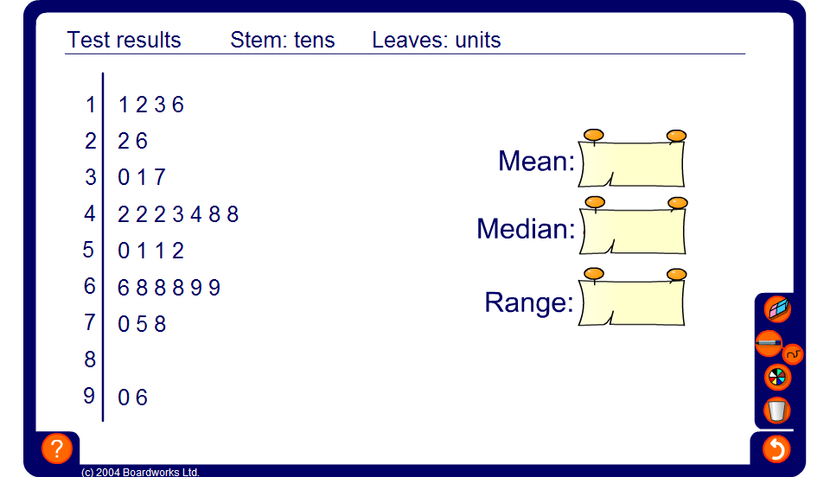

Stem-and-leaf diagrams
Notes:
Calculate the median, mode and range for each stem-and-leaf diagram.

